Slide 1
Non-comparison Sorts
Breaking the Sorting Bound
Recursion / Lecture 6
Franck Chauvel
axbit & NTNU
Go to www.menti.com and use the code 66 89 99 1
franck.chauvel@ntnu.no

Slide 2
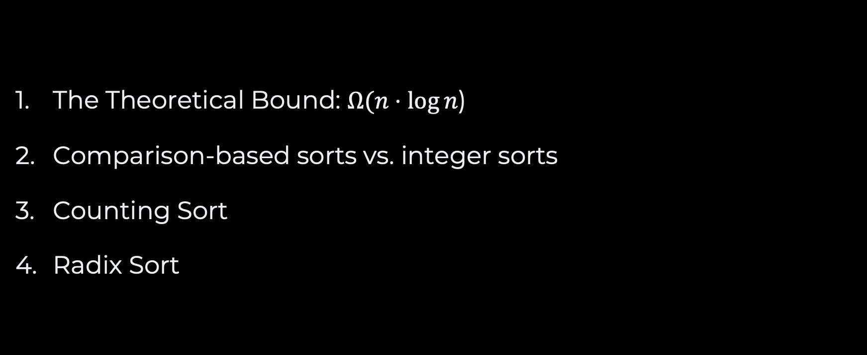
Agenda
The Theoretical Bound: $Ω(n⋅\log{n}$)
Comparison-based sorts vs. integer sorts
Counting Sort
Radix Sort

Slide 3
How fast can it be?
A theoretical lower bound

Slide 4







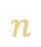
What is Sorting?
Finding a “permutation” that fits the ordering
$$n$$
sort([a, b, c])
$$a<b<c$$
$$a<c<b$$
$$b<a<c$$
$n!$ permutations
$$b<c<a$$
$$c<a<b$$
$$c<b<a$$

Slide 5



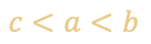
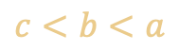


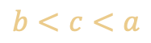

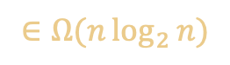

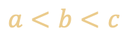
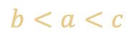
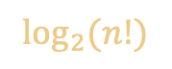
Decision Tree
sort([a, b, c])
$$a<b$$
yes
no
$$b<c$$
$$a<c$$
$$\log_{2}{(n!)}$$
yes
no
yes
no
$$∈Ω(n\log_{2}{n})$$
$$a<c$$
$$b<c$$
yes
no
yes
no
$$a<b<c$$
$$a<c<b$$
$$c<a<b$$
$$b<a<c$$
$$b<c<a$$
$$c<b<a$$
$n!$ permutations

Slide 6
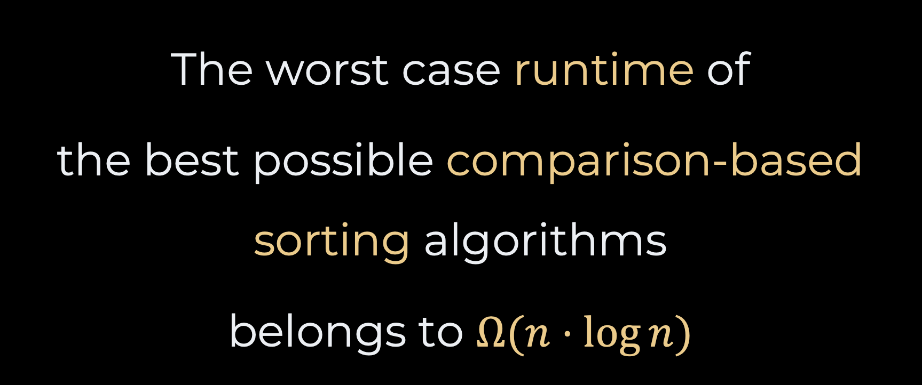
Takeaway
The worst case runtime of
the best possible comparison-based sorting algorithms
belongs to $Ω(n⋅\log{n})$

Slide 7
How to Avoid Comparisons?
Introduction to “integer” sorts

Slide 8


A different understanding
to put in a certain place or rank according to kind, class, or nature
to arrange according to charactticeriss

Slide 9
Counting…
1
1
2
2
2
2
1
2
1
1
1
How would you sort this?
What if you know that it contains only “1” and “2”?

Slide 10
The Idea Counting Sort
1. count
1
1
2
2
2
2
1
2
1
1
1
0
1
2
3
4
5
6
“1” count
0
1
2
3
4
5
“2” count
1
1
1
1
1
1
2
2
2
2
2
6 x 1
5 x 1

Slide 11
Generalization Counting Sort
1
3
2
2
0
2
1
2
0
1
1
0
1
2
3
2
4
4
1
frequencies
0
1
2
3
cumulative
frequencies
2
6
10
11
0
1
2
3
4
5
6
7
8
9
10
0
0
1
1
1
1
2
2
2
2
3

Slide 12


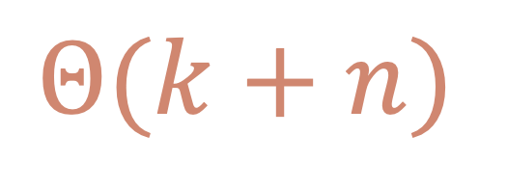
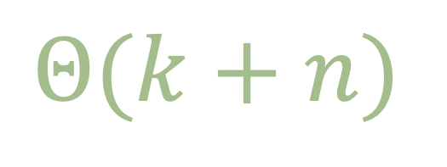
The Code Counting Sort
static int[] countingSort(int[] array, int largestValue) {
int[] frequencies = new int[largestValue+1];
int[] sorted = new int[array.length];
for (int i=0 ; i<array.length ; i++) {
frequencies[array[i]] += 1;
}
for (int i=1 ; i<largestValue+1 ; i++) {
frequencies[i] += frequencies[i-1];
}
for (int i=array.length-1 ; i>=0 ; i--) {
sorted[frequencies[array[i]]-1] = array[i];
frequencies[array[i]] -= 1;
}
return sorted;
}
$$Θ(k+n)$$
$$Θ(k+n)$$

Slide 13
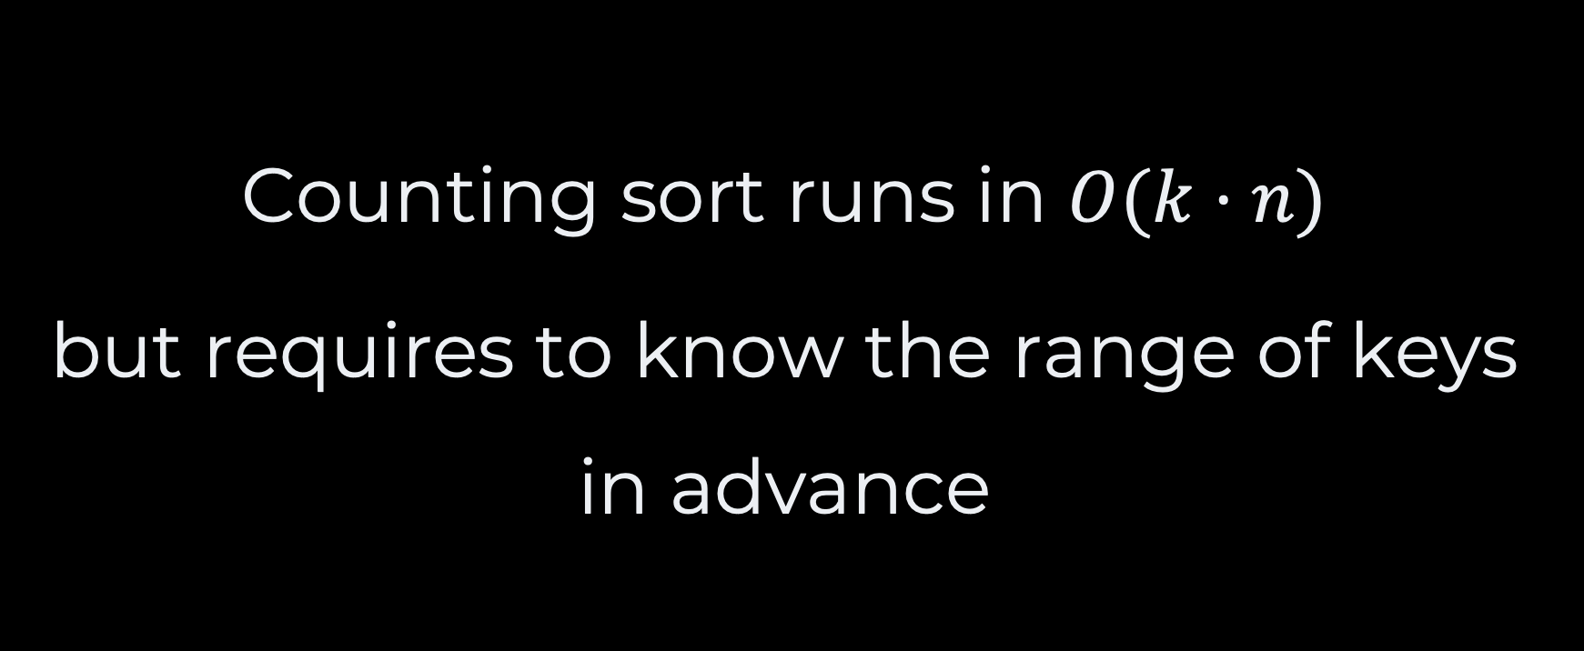
Takeaway
Counting sort runs in $O(k⋅n)$
but requires to know the range of keys in advance

Slide 14
What if we don’t?
How could we process unbounded keys?

Slide 15
Radix Sort Using the least significant digit (LSD)
0
1
2
3
4
5
6
7
8
9
59
494
59
106
37
494
23
382
4192
78
89
321
106
37
23
382
4192
78
89
321
counting sort
4192
23
321
382
4192
23
106
37
494
106
37
78
59
321
382
494
78
59
89
89
counting sort
106
321
23
37
59
78
382
89
4192
494
106
321
23
37
59
78
382
89
4192
494
counting sort
23
37
59
78
89
106
106
4192
4192
321
321
382
382
494
494
counting sort
23
37
59
78
89
106
321
382
494
4192

Slide 16
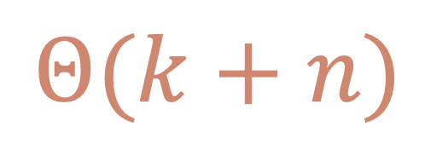
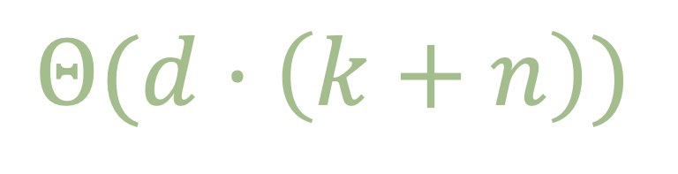
The Code Radix Sort
$$Θ(d⋅\left(k+n\right))$$
static int[] radixSort(int[] array) {
int[] sorted = array;
int maximum = findMaximum(array);
int digitCount = countDigits(maximum);
for(int digit=0 ; digit<digitCount ; digit++) {
sorted = countingSort(sorted, digit);
}
return sorted;
}
$$Θ(k+n)$$

Slide 17
The Code Radix Sort / Helpers
static int findMaximum(int[] array) {
if (array.length == 1) return array[0];
int maximum = array[0];
for(int any_index=0 ; any_index<array.length ; any_index++) {
if (array[any_index] > maximum) {
maximum = array[any_index];
}
}
return maximum;
}
static int digitAt(int number, int position) {
int divisor = (int) Math.pow(10, position);
return (number / divisor) % 10;
}

Slide 18
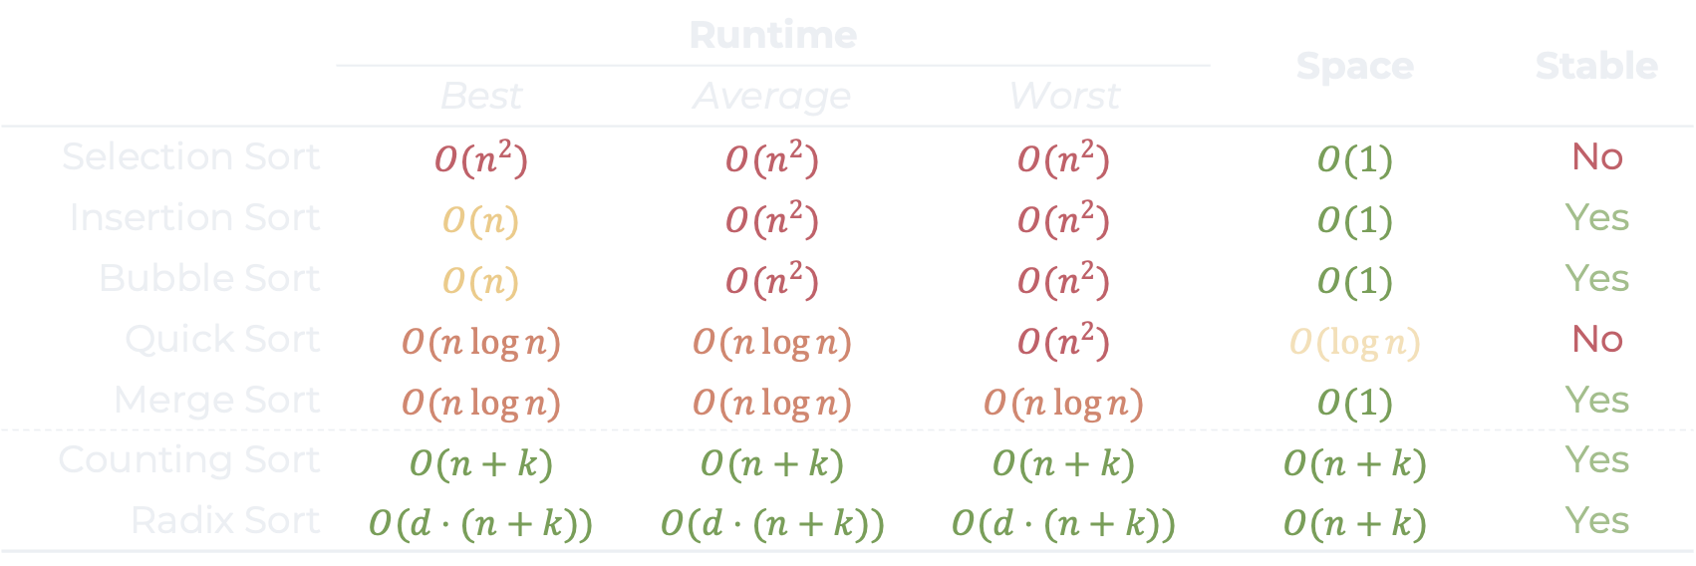
Sorting Algorithms
 |  | Runtime |  | Space | Stable
 | Best | Average | Worst | Space | Stable
Selection Sort | $$O(n^{2})$$ | $$O(n^{2})$$ | $$O(n^{2})$$ | $$O(1)$$ | No
Insertion Sort | $$O(n)$$ | $$O(n^{2})$$ | $$O(n^{2})$$ | $$O(1)$$ | Yes
Bubble Sort | $$O(n)$$ | $$O(n^{2})$$ | $$O(n^{2})$$ | $$O(1)$$ | Yes
Quick Sort | $$O(n\log{n)}$$ | $$O(n\log{n)}$$ | $$O(n^{2})$$ | $$O(\log{n)}$$ | No
Merge Sort | $$O(n\log{n)}$$ | $$O(n\log{n)}$$ | $$O(n\log{n)}$$ | $$O(1)$$ | Yes
Counting Sort | $$O(n+k)$$ | $$O(n+k)$$ | $$O(n+k)$$ | $$O(n+k)$$ | Yes
Radix Sort | $$O(d⋅(n+k))$$ | $$O(d⋅(n+k))$$ | $$O(d⋅(n+k))$$ | $$O(n+k)$$ | Yes

Slide 19
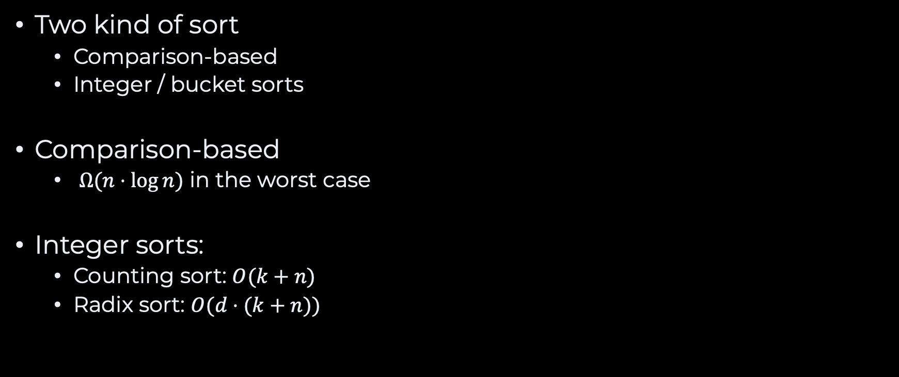
Recap
Two kind of sort
Comparison-based
Integer / bucket sorts
Comparison-based
$Ω(n⋅\log{n)}$ in the worst case
Integer sorts:
Counting sort: $O(k+n)$
Radix sort: $O(d⋅(k+n))$
We will stop here for
sorting algorithms

Slide 20
Questions, Comments, or Ideas?
Franck Chauvel
Axbit & NTNU
franck.chauvel@ntnu.no

